Slide 1
Digital Portfolio
STUDENT NAME: Jeevadharshini S
REGISTER NO AND NMID: 2428c0478 and 244350A99E54D4585C649BD78FDE4022
DEPARTMENT: 2nd B.sc AIML
COLLEGE:KPR College Of Arts Science And Research

Slide 2
PROJECT TITLE
Curriculum Developer Portfolio

Slide 3


AGENDA
Problem Statement
Project Overview
End Users
Tools and Technologies
Portfolio design and Layout
Features and Functionality
Results and Screenshots
Conclusion
Github Link
3/21/2024 Annual Review

Slide 4

PROBLEM STATEMENT
Traditional educational resources often lack interactivity, personalization, and alignment with modern learning needs.Many students and organizations face challenges in finding content that is structured, engaging, and adaptable.There is a demand for well-designed, innovative curriculum solutions that leverage technology to create better learning experiences.

Slide 5

PROJECT OVERVIEW
This project focuses on designing a professional portfolio.
That reflects my capabilities as a curriculum developer and web developer.
The portfolio not only demonstrates my expertise in creating curriculum and e-learning solutions but also showcases web-based project development, emphasizing creativity, technology integration, and content organization.

Slide 6

WHO ARE THE END USERS?
Students
Educators and Trainers
Organizations and Recruiters
Collaborators

Slide 7

TOOLS AND TECHNIQUES
Html ,Css, Javascript
Dynamic web page
GitHub pages(for deployment)
Vs code (for deployment)

Slide 8
PORTFOLIO DESIGN AND LAYOUT
Sections: About, Skills, Projects,Contact
Projects with Details and Screenshots
Contact Section with Interactive Forms
Downloadable Resume and GitHub Link
8

Slide 9
FEATURES AND FUNCTIONALITY
Works seamlessly on all devices.
Smooth scrolling and easy-to-use menu.
Detailed project descriptions with images and links.
A functional contact form for direct communication.
Engaging UI/UX design with animations.
Graphical representation of skills and expertise.

Slide 10
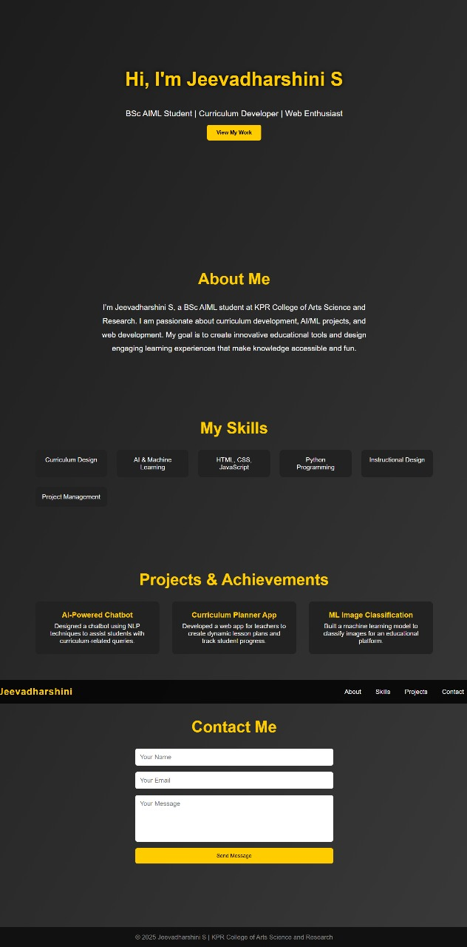

RESULTS AND SCREENSHOTS
My professional skill set as a curriculum developer.
My web development and design abilities.
3/21/2024 Annual Review
10

Slide 11
CONCLUSION
This portfolio reflects my commitment to delivering quality curriculum design and technical solutions. It demonstrates my creativity, problem-solving skills, and ability to integrate educational principles with web technologies, making me well-suited for roles in education, development, and instructional design.
11

Slide 12
GITHUB LINK
https://github.com/jeevadharshini09/curriculum-portfolio-.git

